Slide 1
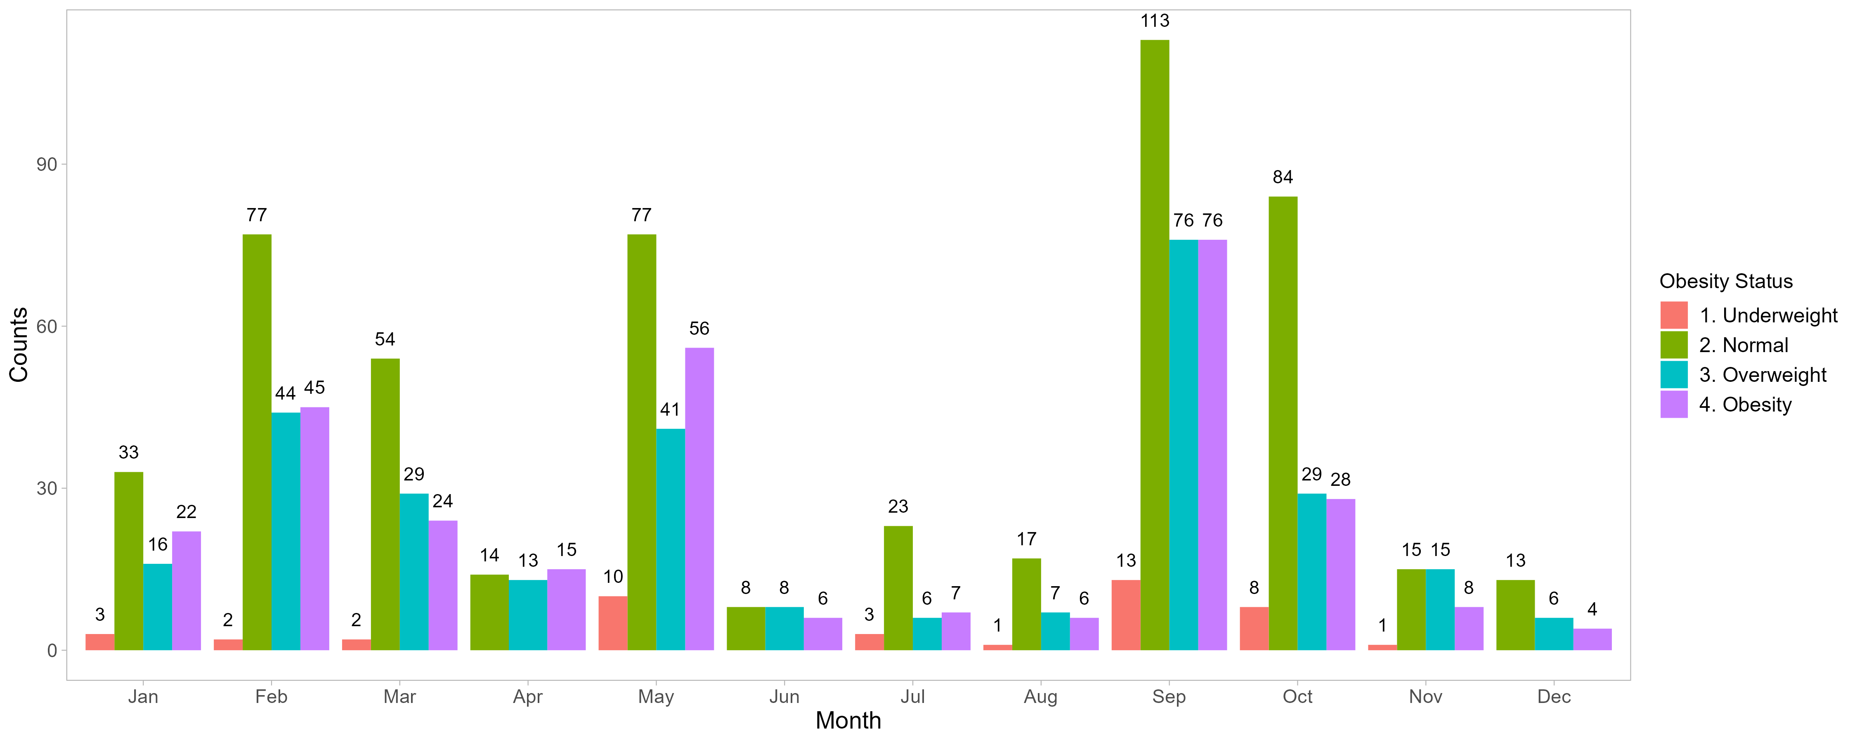
Q1 UW n = 7
NW n = 164
OW n = 89
OB n = 91
Q2
UW n = 10
NW n = 99
OW n = 62
OB n = 77
Q3
UW n = 17
NW n = 153
OW n = 89
OB n = 89
Q4
UW n = 9
NW n = 112
OW n = 50
OB n = 40

Slide 2
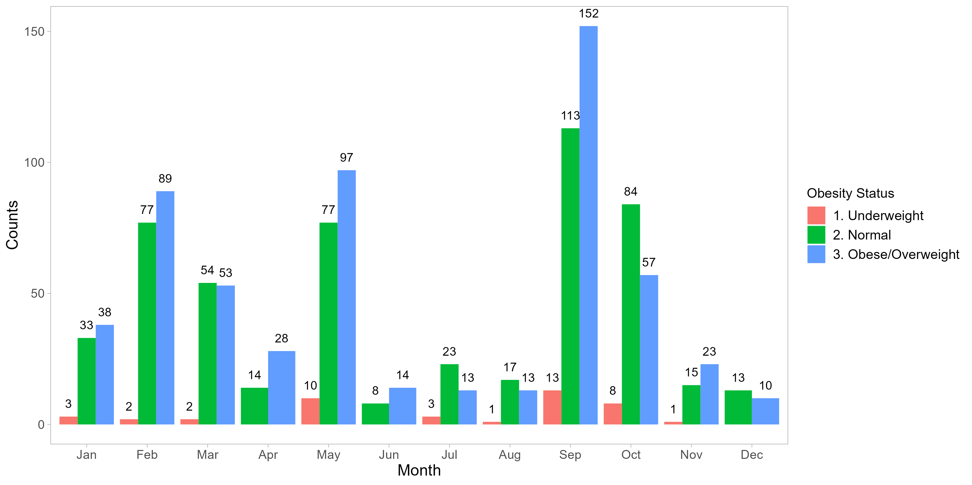
Q1 UW n = 7
NW n = 164
OW n = 180
Q2
UW n = 10
NW n = 99
OW n = 139
Q3
UW n = 17
NW n = 153
OW n = 178
Q4
UW n = 9
NW n = 112
OB/OW n = 90

